Slide 1

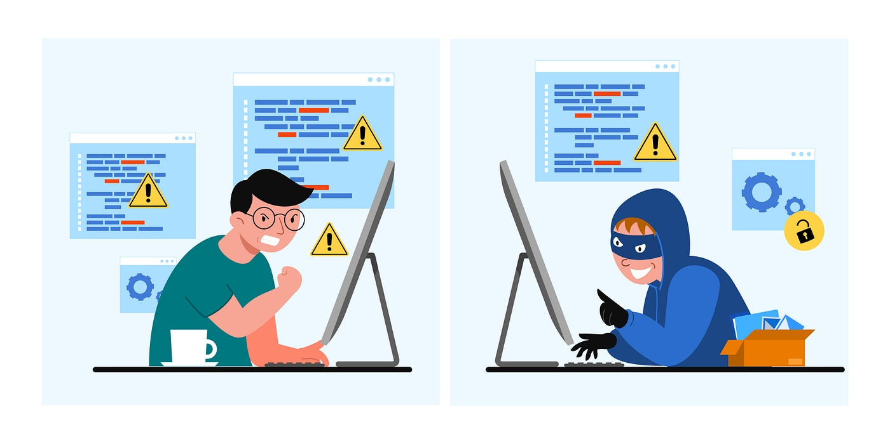
FRAUD DETECTION
Presented by:
B. Sai Madhavi
Ruchi Bhatt
Shashank
Naman
Vishal

Slide 2

What is Fraud
For years, fraud has been a serious issue in sectors like banking, medical, insurance and almost all the areas especially because of the rise in online transactions through different online mode like net banking, credit/debit cards payment, PhonePe.
Nowadays, Machine Learning Algorithms in Artificial Intelligence provides intelligent solutions to most of the problems that manual and traditional approach beings find tough to deal with particularly within the field of fraud detection.
According to PwC's 2022 Global Economic Crime and Fraud Survey, for example, 46% of the respondents experienced at least one type of fraud over the previous 24 months. The study also reported a rising threat from external perpetrators, who typically leverage the new technologies adopted by modern businesses, such as ecommerce platforms and social media, as a hidden door to access users’ assets and personal data.
Sadly, the ML-based countermeasures deployed to address this massive issue have been rather mild. According to ACFE's 2022 Anti-Fraud Technology Benchmarking Report, for example, only 17% of organizations surveyed used AI and machine learning to detect fraud.

Slide 3

Business objectives
Credit card fraud detection is an immenent problem to every company in the banking industry. Detecting and preventing credit card fraud is a necessity for banks.
Hence, our objective here is to develop a machine learning model that detects fraudulent transactions based on the historical transactional data of customers with a pool of merchants and provide a cost benefit analysis of the model to the stakeholders and provide them with appropriate recommendations to adopt in order to mitigate fraud risks.

Slide 4
Data set description
The dataset is taken from Kaggle, real-time fraud detection. It contains 1296675 rows and 22 columns.
trans_date_trans_time: The date and time of the transaction.
cc_num: credit card number
merchant: Merchant who was getting paid.
category: In what area does that merchant deal
amt: Amount of money in American Dollars
First, last : first and last name of the card holder.
gender: Gender of the cardholder.Just male and female
street:Street of card holder residence
city:city of card holder residence
state:state of card holder residence
zip: ZIP code of card holder residence
Lat and long :latitude and longitude of card holder
city_pop:Population of the city
job:trade of the card holder
Dob:Date of birth of the card holder
trans_num: Transaction ID
unix_time: Unix time which is the time calculated since 1970 to today.
merch_lat and merch long: latitude and longitude of the merchant
is_fraud: Whether the transaction is fraud(1) or not(0)
https://www.kaggle.com/datasets/dermisfit/fraud-transactions-dataset

Slide 5
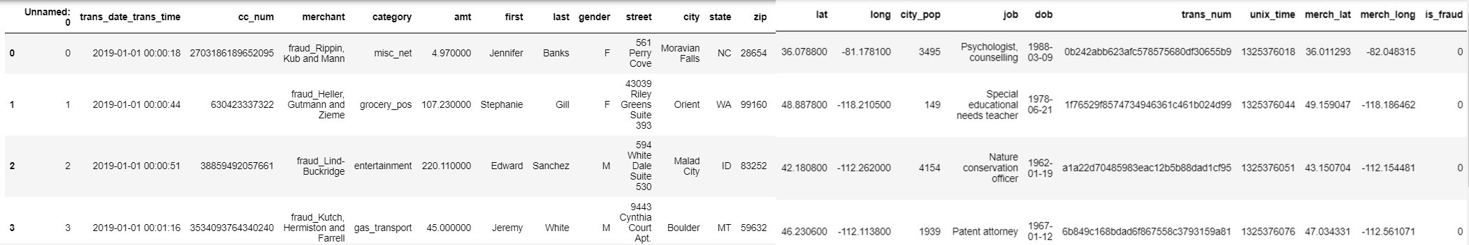
Dropped Unnamed Column.
Changed the datatype of 'trans_date_trans_time' and split it into separate date and time columns.
Combined the first and last columns to create a new column called "name".
Dropped 'trans_year' due to a standard deviation of zero, indicating it wouldn't contribute to the model.
Calculated the difference in longitude and latitude between the customer's and merchant's locations, considering each degree to be approximately 69 miles or 110 kilometers. Used Pythagoras theorem to estimate displacement.
Kept the state column instead of street, city, and zip, as state encompasses city and zip code.

Slide 6
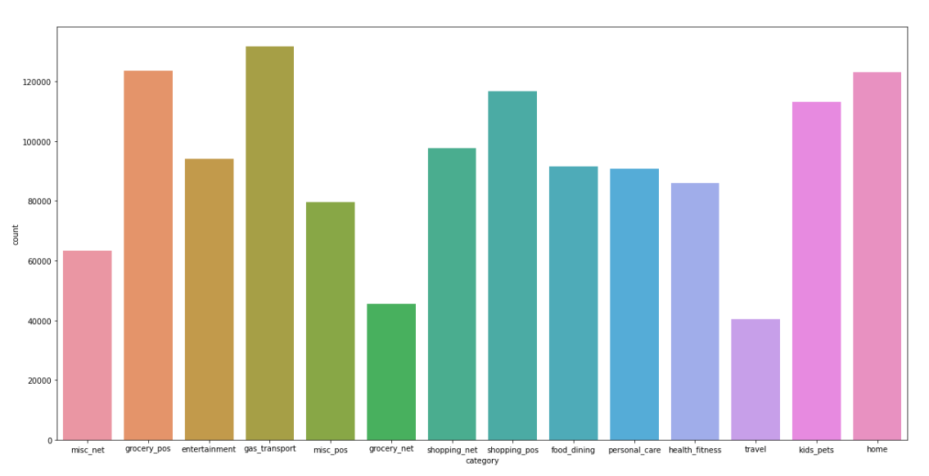
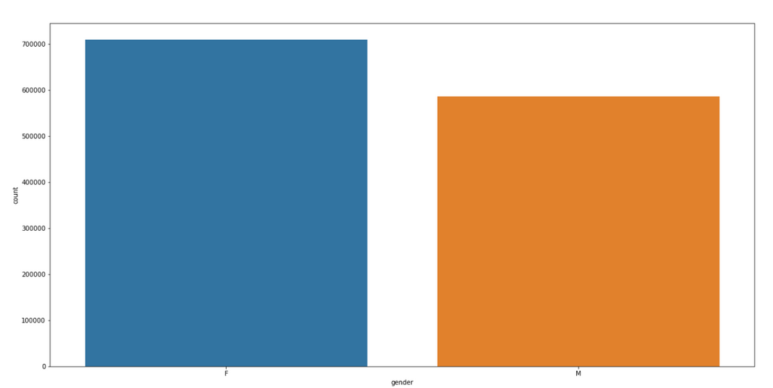
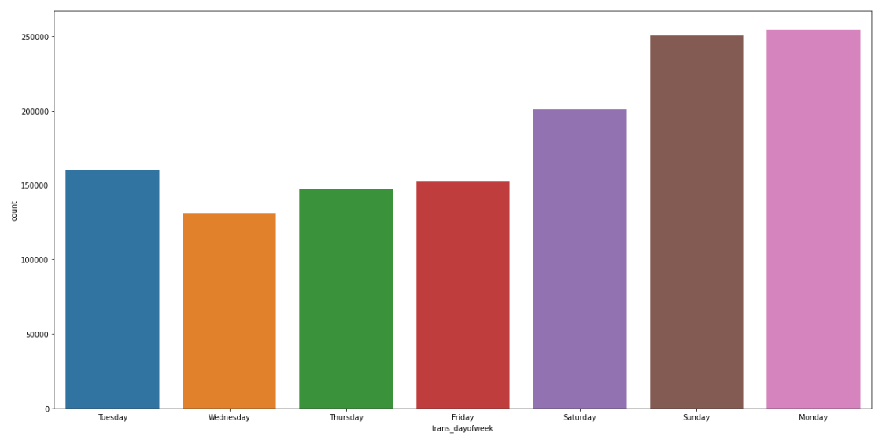
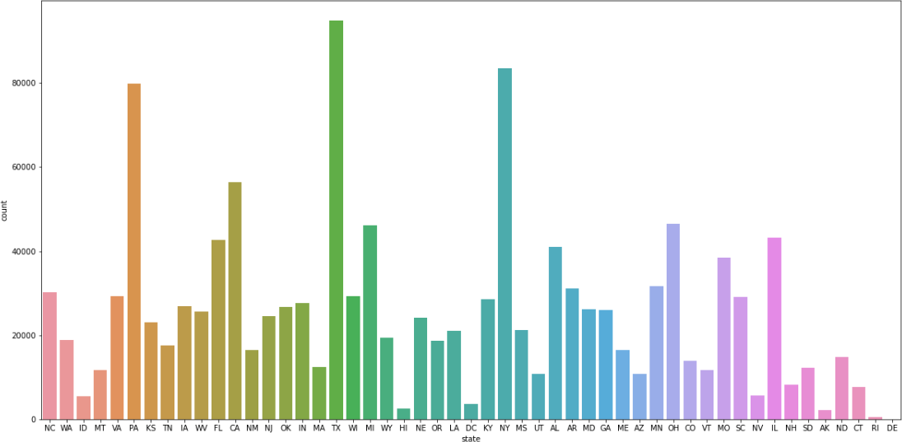
UNIVARIATE ANALYSIS

Slide 7
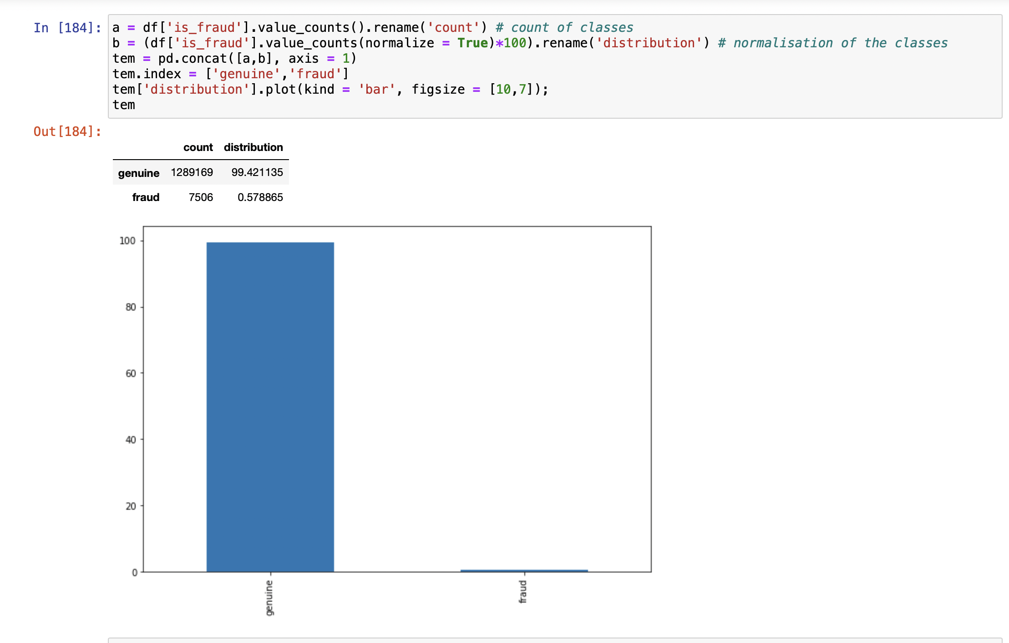
Distribution of Target variable

Slide 8
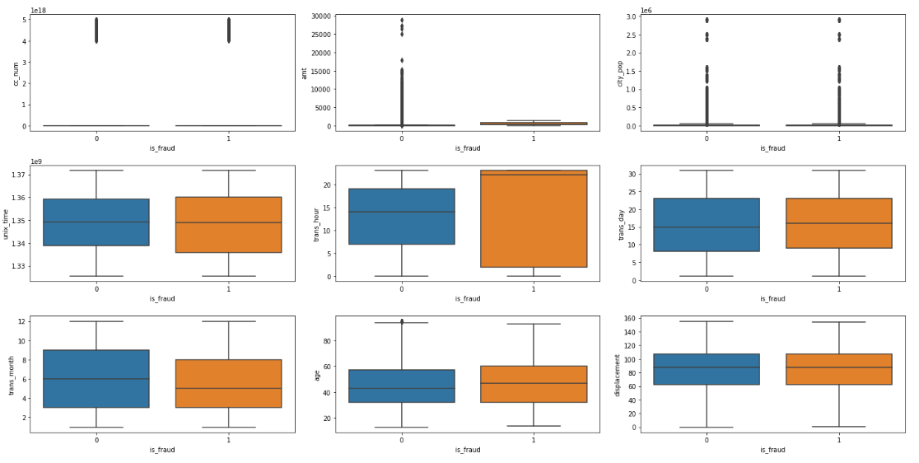
Distribution of numerical variables
State and category show some significant differences in between actual frauds.
Gender and trans_day of week show no significant differences in between actual frauds.
CC_num, city_pop, unix_time, trans_day, age and displacement are overlapping which means there is no such significant differences.

Slide 9
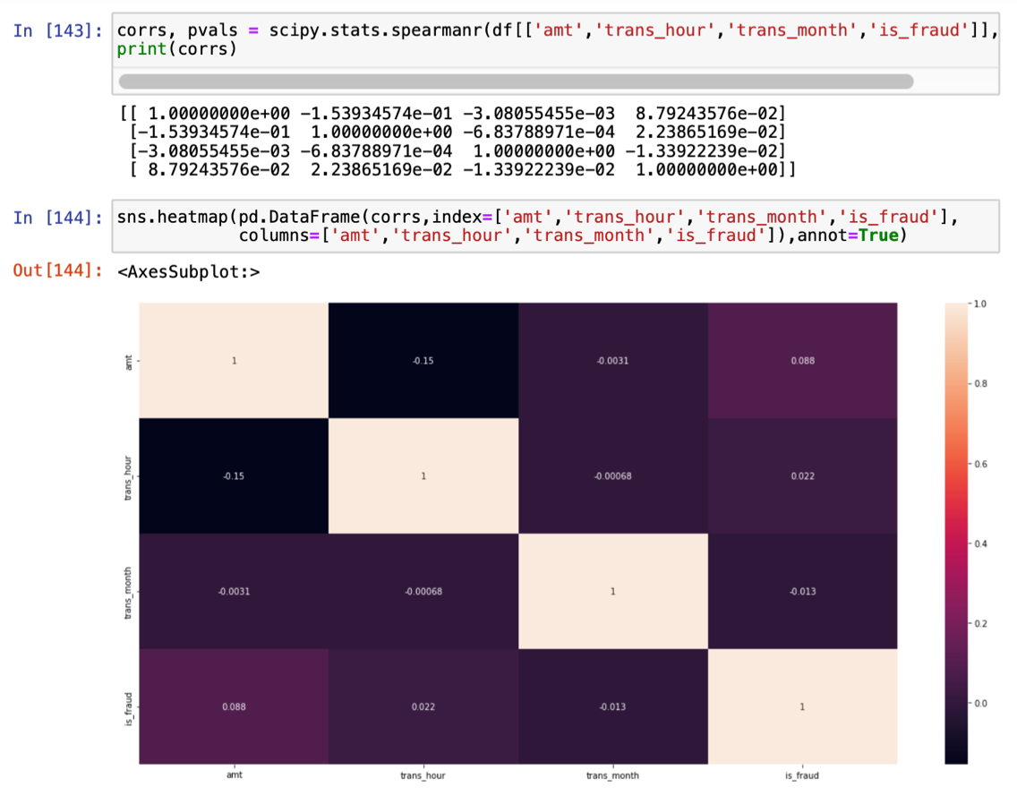
Correlation between variables

Slide 10

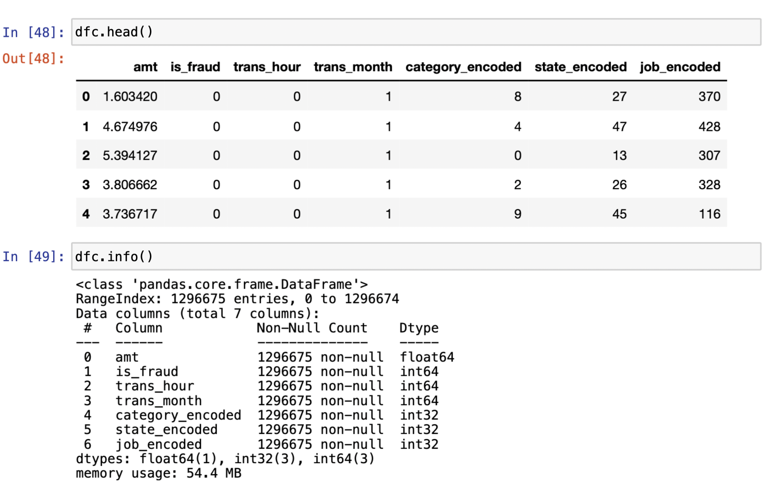
Feature Engineering
The variables category, state and job Label encoding has been applied
The features 'zip', 'lat', 'long', 'city_pop', 'unix_time', 'merch_lat','merch_long' have been assumed to provide no significant information in the model building phase. Hence, they along with the original features that have been encoded have been dropped from the dataset.
Log transformation has been applied to the amount column

Slide 11

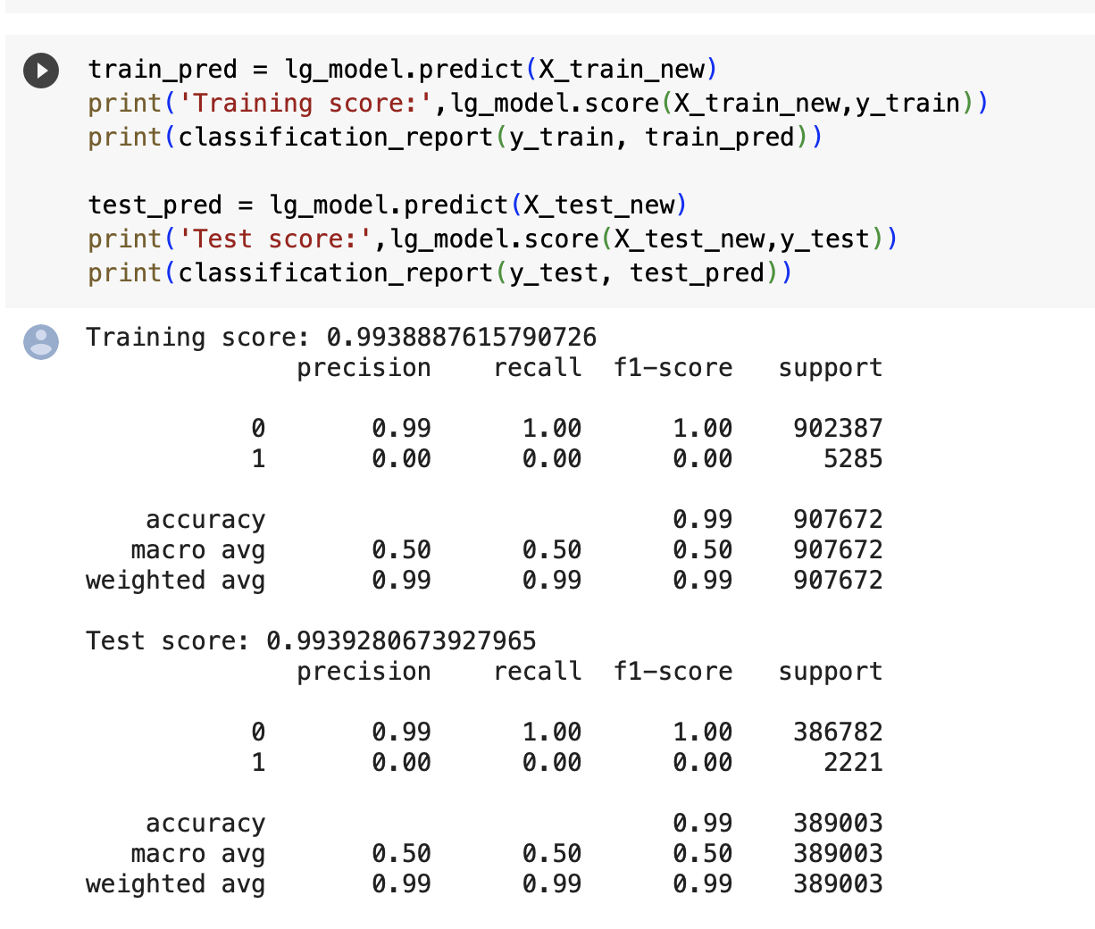
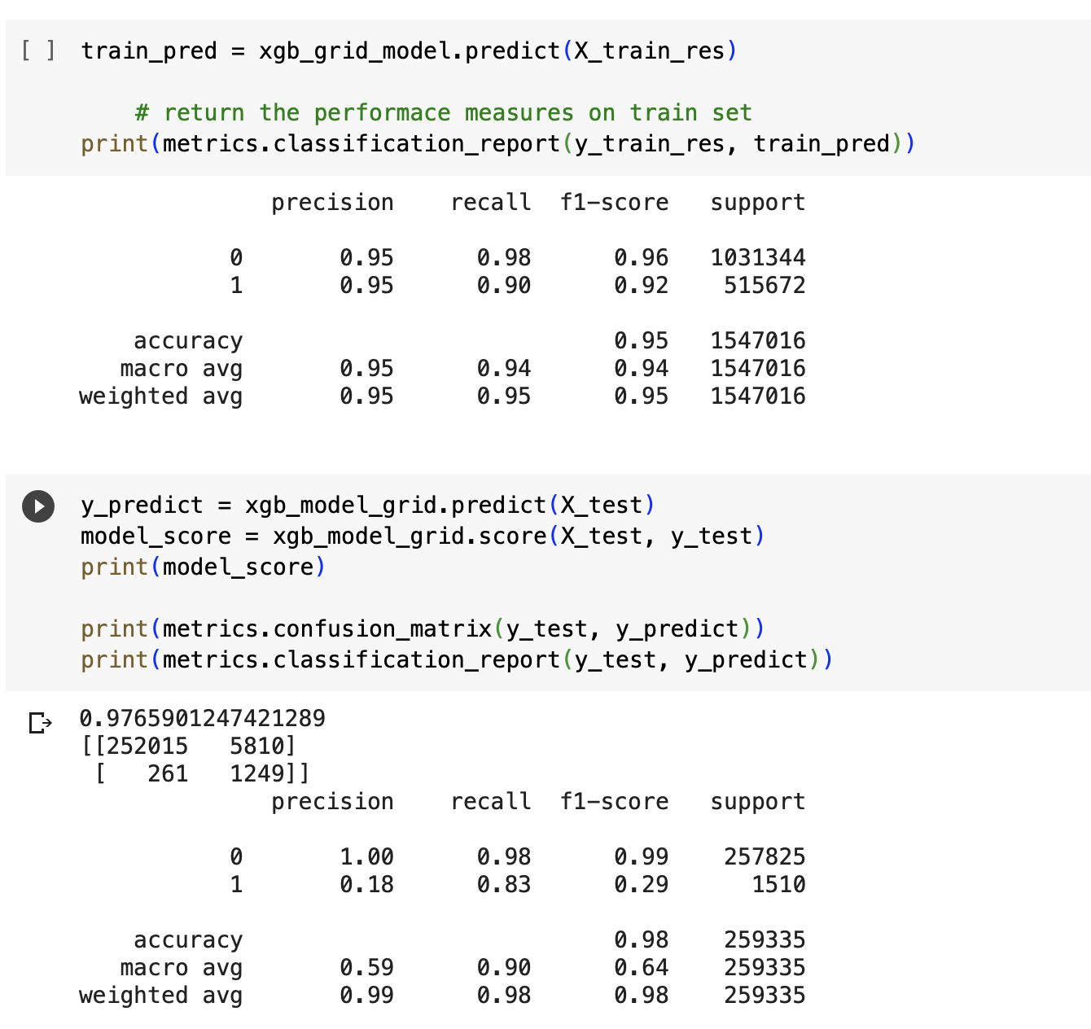
Basic model

Slide 12

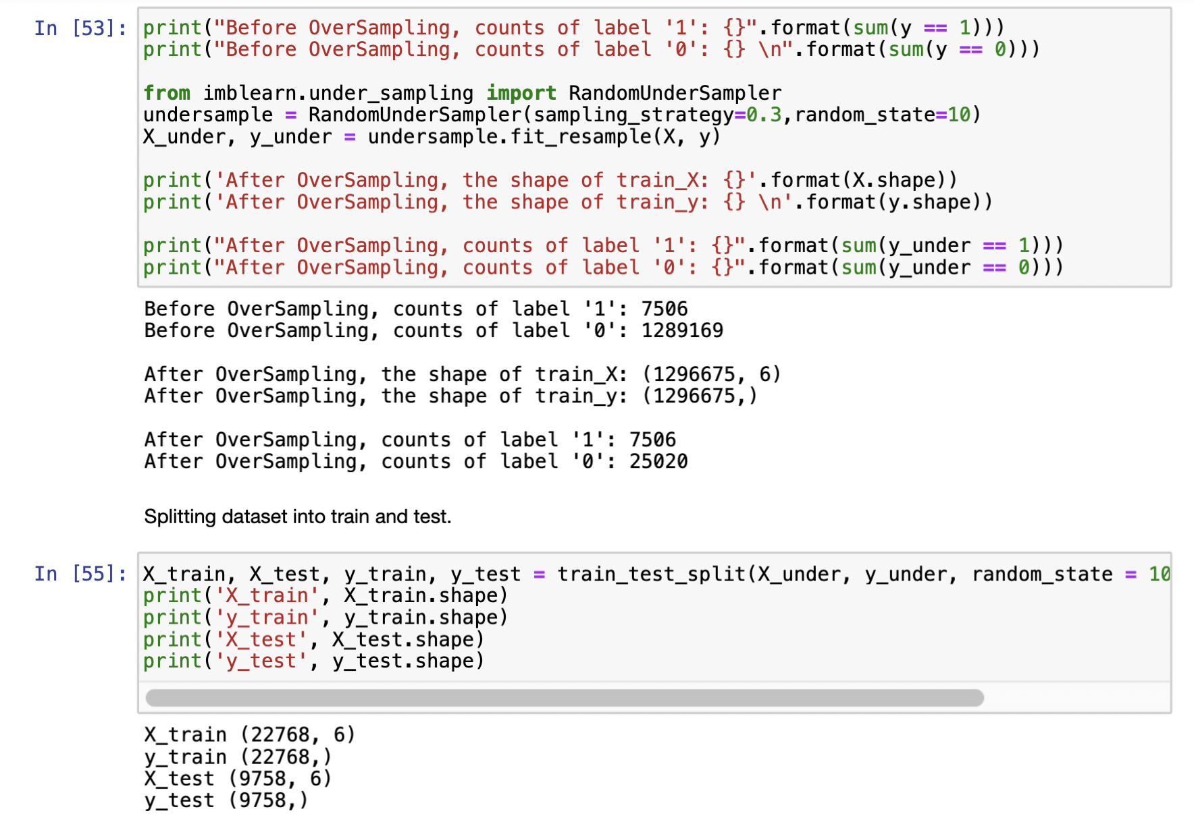
Undersampling

Slide 13
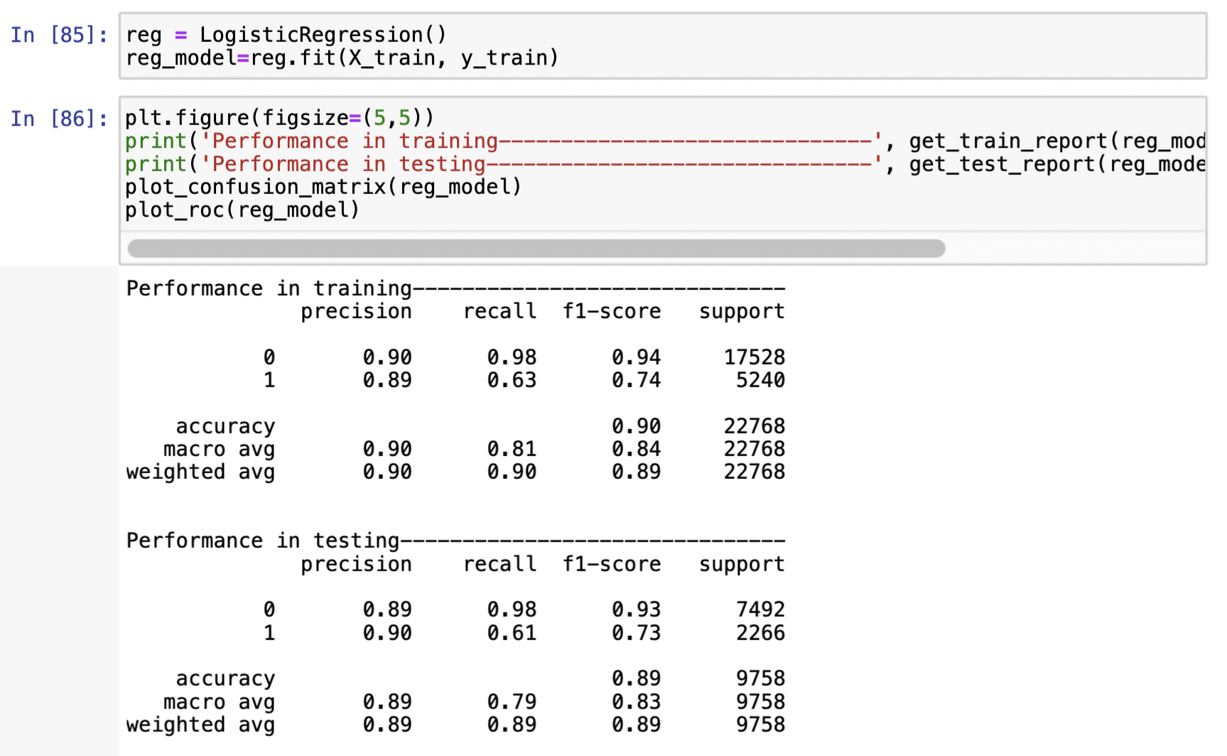
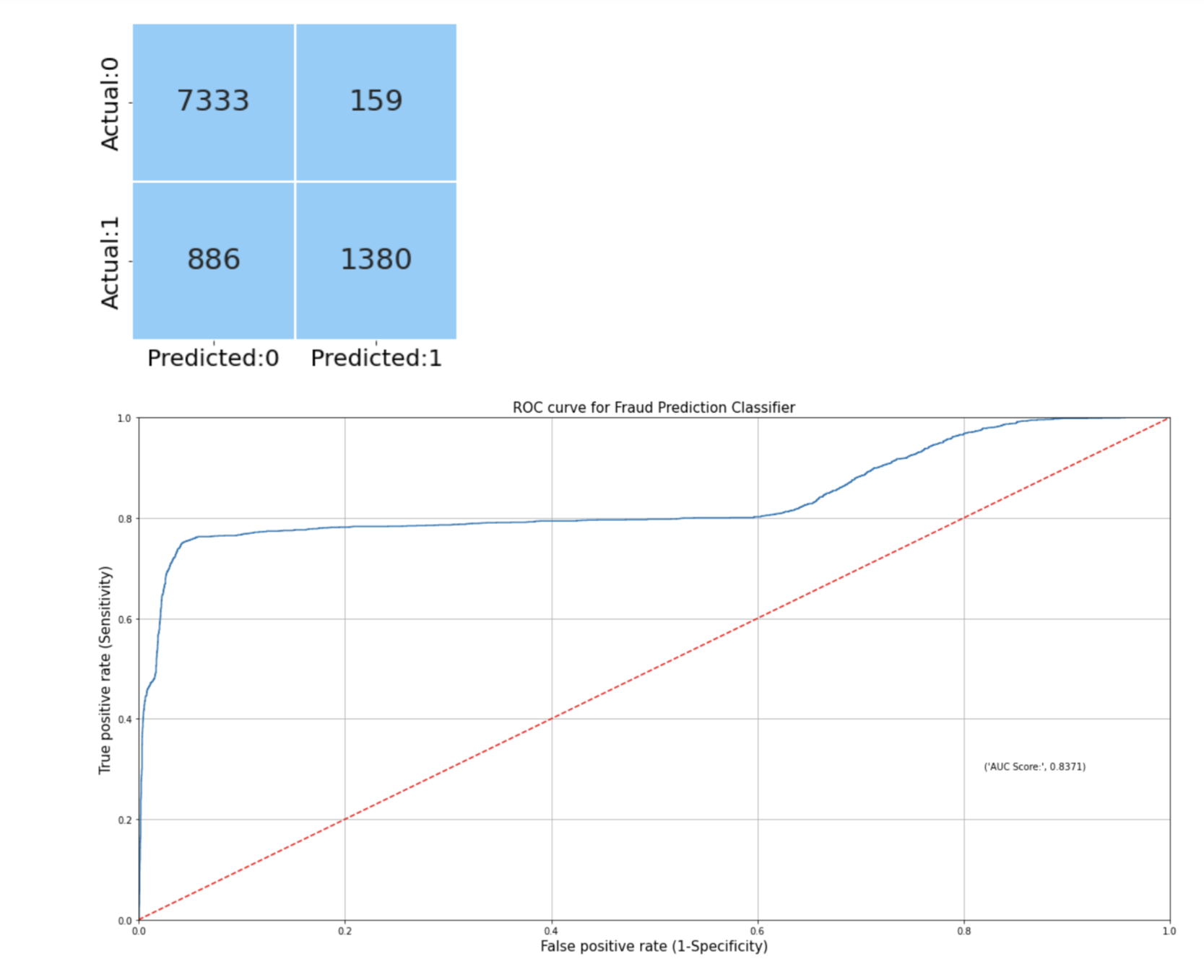
Model after under sampling

Slide 14
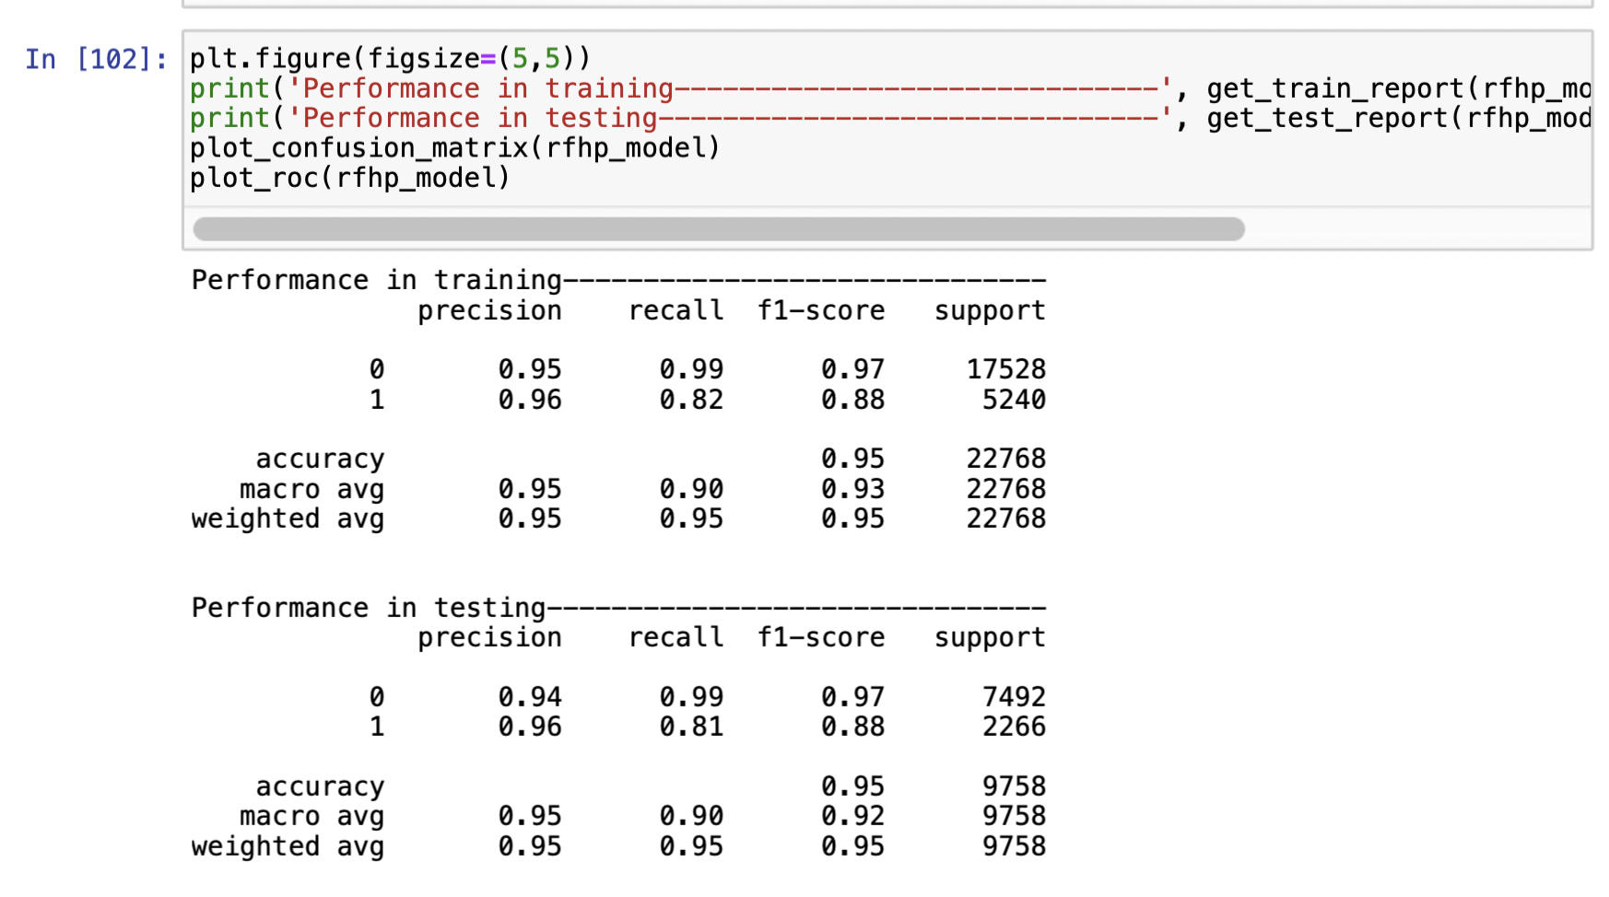
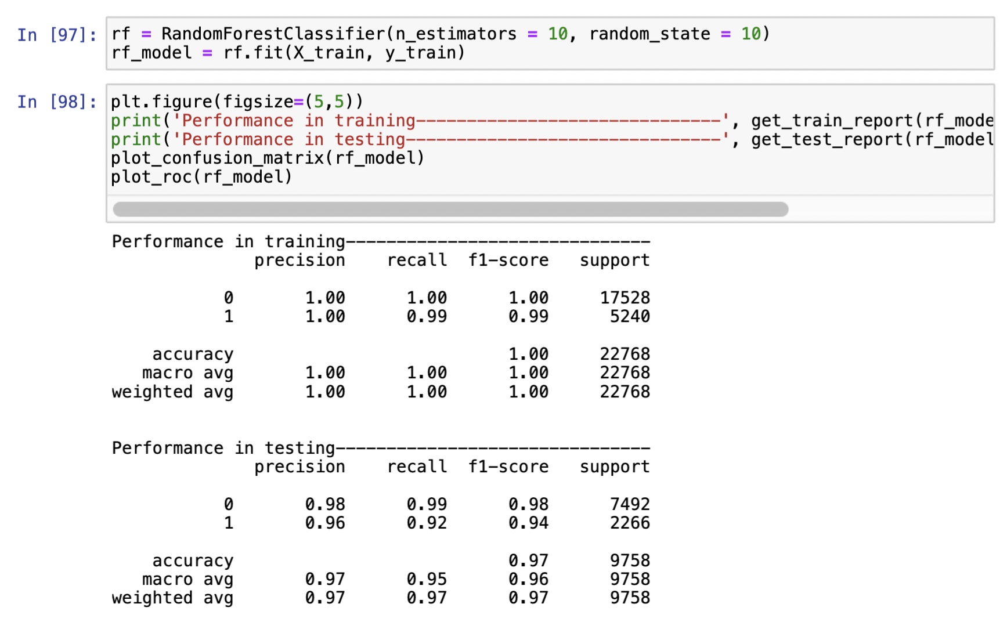
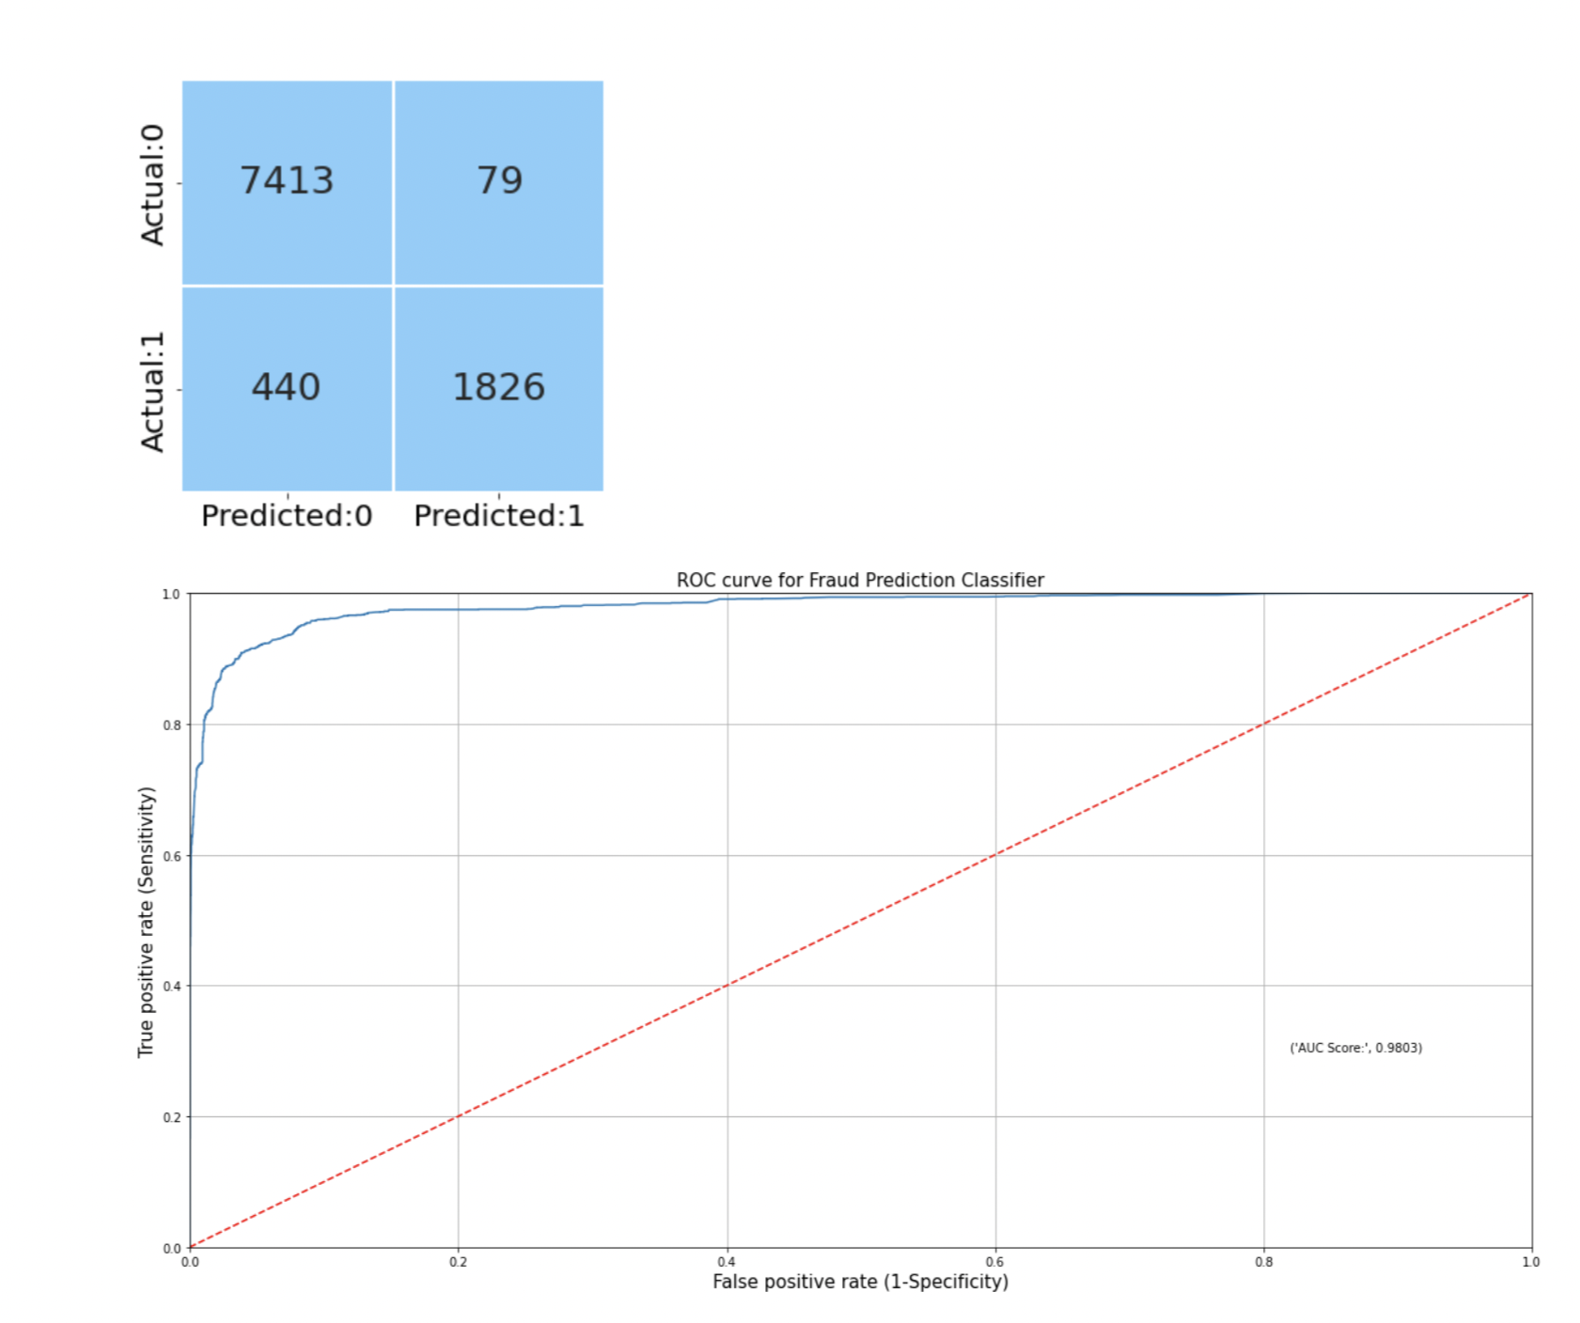
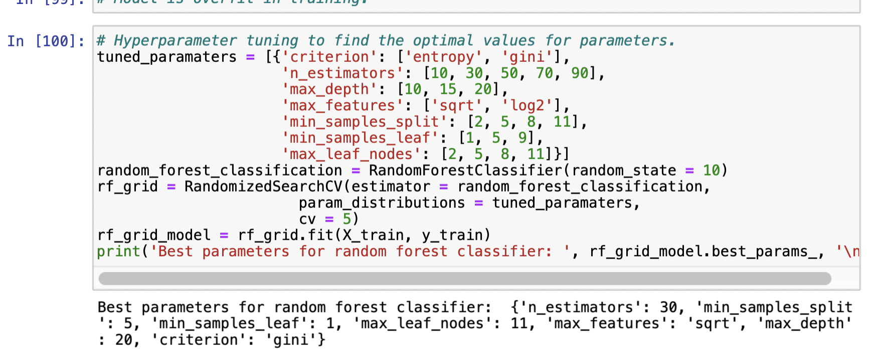
Final optimization of the model

Slide 15

Conclusion and Future perspective
Final model has been developed for fraud detection using Random forest and the accuracy was found to be 95%
Fraud detection models heavily rely on the quality and availability of data. If the data used for training the model is incomplete, inaccurate, or biased, it can negatively impact the model's performance. Additionally, if there is a lack of labeled data representing fraudulent activities, the model may struggle to learn effectively
Fraudsters continually develop new techniques to evade detection, and fraud detection models may not be able to keep up with these evolving strategies. The model might be effective against known patterns of fraud, but it could struggle to identify new or sophisticated fraudulent activities.
Fraud patterns and behaviors can change over time, leading to concept drift. If the model is not regularly retrained or adapted to these changes, its performance may degrade over time. Continuous monitoring and model maintenance are necessary to ensure its effectiveness.

Slide 16

THANK YOU

